Slide 1

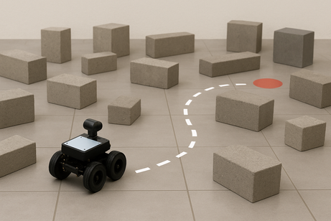
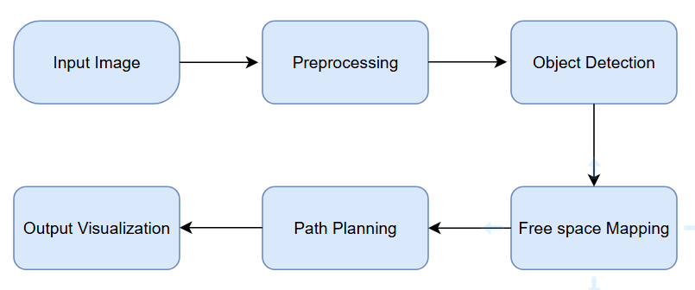
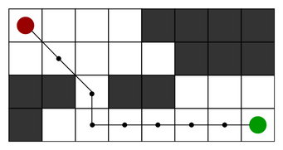
Obstacle Detection & Free Space Mapping for Robot Navigation
Iqra Khadam (22-CP-35), Attia Batool (22-CP-79)
Supervised By: Dr. Haroon Yousaf
The main problem is to use digital image processing to extract obstacles and free space from raw images so a robot can navigate an unknown environment.
F
  Majeed, S. et al., 2019: DIP techniques for obstacle detection and path planning
  Singh, K. J. et al., 2020: Image-based detection for indoor robot navigation
Problem Statement
Literature Review
Methodology
  The system takes input images or video of unknown environments.
  Images are preprocessed to reduce noise and enhance features.
  Obstacles are detected using edge detection and segmentation.
  A collision-free path is planned from start to goal using the A* algorithm.
  The output is visualized by overlaying detected obstacles and the planned path on the image.
Figure 1: Scene with obstacles the robot must navigate through.
  Accuracy: Correct detection of obstacles and free space
  Path Efficiency: Shortest and collision free path from start to goal
  Processing Time: How fast the system computes the path
Performance Evaluation
  WP1 – Depth of Knowledge: Robots must navigate unknown environments safely.
  WP2 – Conflicting Requirements: Must balance accuracy, speed, and reliability under unpredictable conditions.
  WP3 – Depth of Analysis: Requires advanced analysis to detect obstacles and plan a path.
Why CEP?
Figure 2: Computed path from start (red) to goal (green) avoiding obstacles
TUM RGB‑D and ICL‑NUIM.
Dataset
Figure 3: Methodology flow showing key steps and their sequence in the project.

